Slide 1
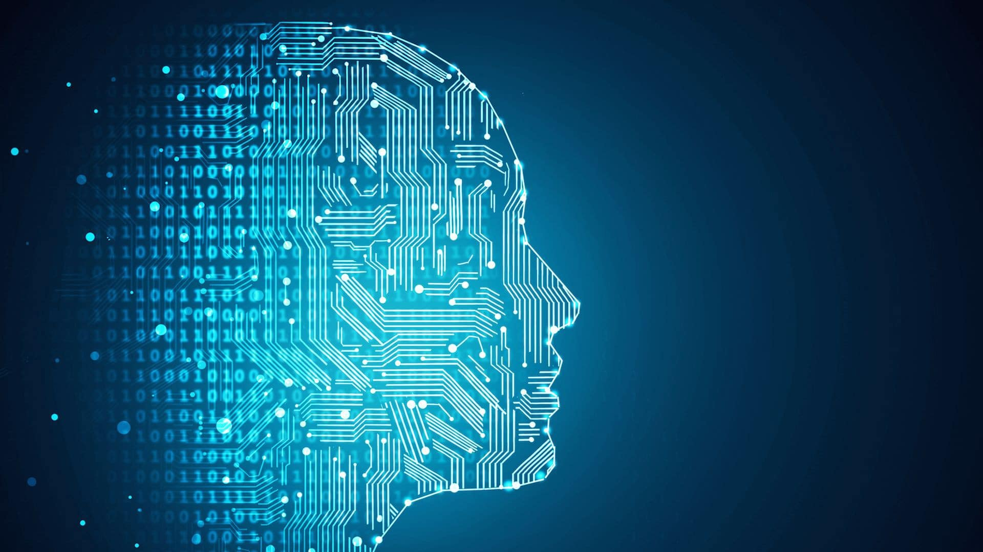

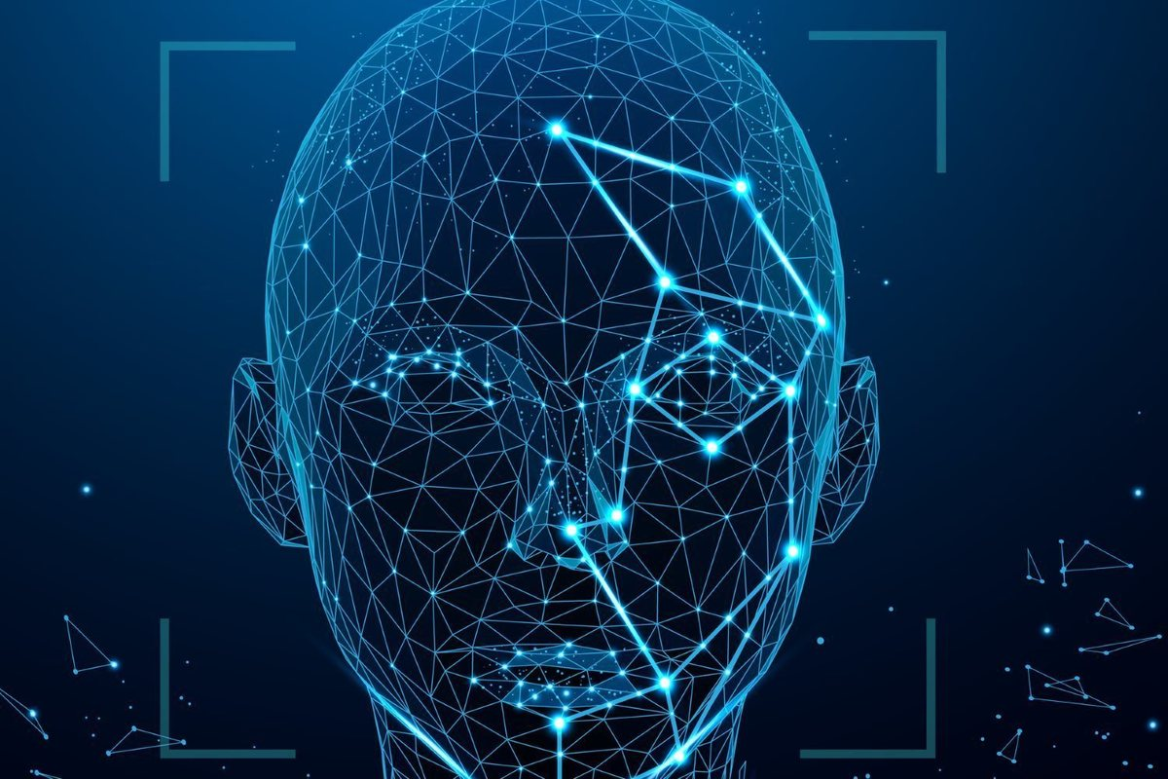
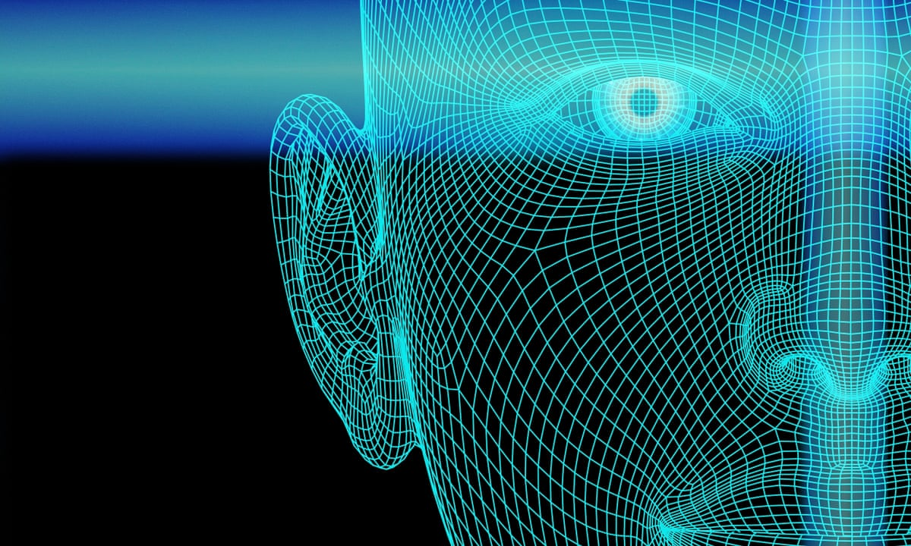
MAULANA ABUL KALAM AZAD
UNIVERSITY OF TECHNOLOGY,
WEST BENGAL
BSC IN IT ( DATA SCIENCE )
Project Supervisor: DIPIKA DHARA
Project 0f 1st Year, 2nd Sem. Submitted by….
1. ARPAN DATTA. [ Reg. No. : 203002484310003 ]
2. ANIRBAN DEBNATH. [ Reg. No. : 203002484310010 ]
3. SACHIN SARKAR. [ Reg. No. : 203002484310001 ]
4. SAYAN MONDAL. [ Reg. No. : 203002484310012 ]

Slide 2
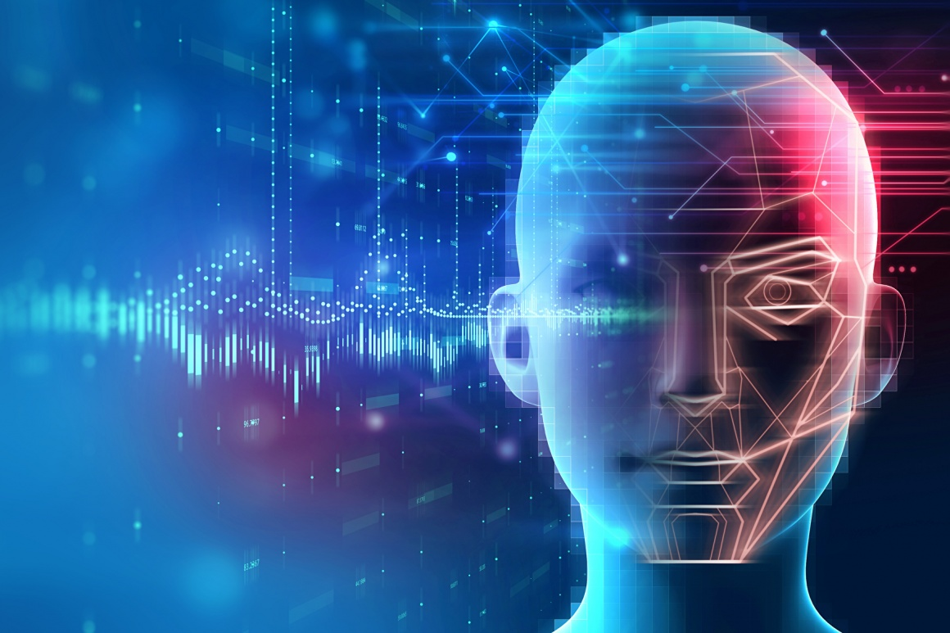
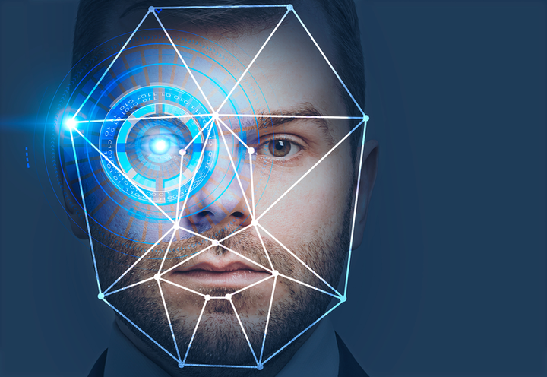
Facial
Expressions
Recognition
System
The Project Presented by -
17%
Arpan Datta.
Anirban Debnath.
Sachin Sarkar.
Sayan Mandol.
Angry
0%
Smile

Slide 3
01
Intro…
Facial expression recognition is the task of classifying the expressions on face images into various categories such as anger, fear, surprise, sadness, happiness and so on.
In this project we applied various deep learning methods (convolutional neural networks) to identify the key seven human emotions: anger, disgust, fear, happiness, sadness, surprise and neutrality.

Slide 4

What is Image
Processing?
02
Image processing is a method to perform some important operations on an image. In order to get an enhanced high Quality image or to extract the most useful information from that : ---
It is one type of signal processing.
2) In this method input is the image and output maybe the the image but along with it's feature.
3) Convolution Neural Network Or CNN a Deep Learning Approach popularly known for Image Processing..

Slide 5
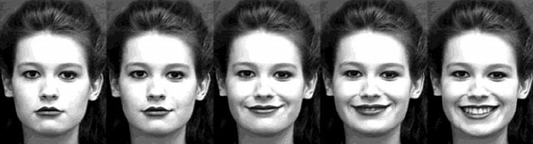
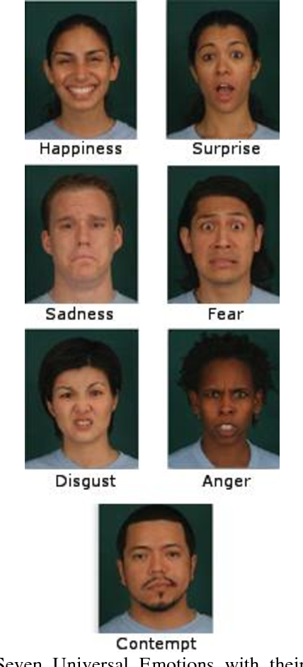
v
03
About
v
The Dataset
Dataset Used : FER2013 Facial Expression Dataset
The data consists of 48x48 pixel grayscale images of faces. The faces have been automatically registered so that the face is more or less centred and occupies about the same amount of space in each image.
The task is to categorize each face based on the emotion shown in the facial expression into one of seven categories (0=Angry, 1=Disgust, 2=Fear, 3=Happy, 4=Sad, 5=Surprise, 6=Neutral). The training set consists of 28,709 examples and the public test set consists of 3,589 examples.

Slide 6


04
Methodology
Input Image
Happy 93%
Face Detection
Identified Expression(OutPut)
Pre Processing
User
Emotion Classification
Facial Feature Extraction

Slide 7
05
Input Image
We input 4 images of us as input to experiment the dataset. This images will preprocessed and than predicted by the CNN model which assumed to be fitted with the training set already.
What we have already imported in the system's dataset :
A Total of 32298 Images imported from FER2013 Dataset.
From which total number of Images going to used as Training the model is 28709 And total number of Images going to used as Validate the model is 3589.

Slide 8
06
Face Detection
In this part we use haarcascade_frontalface_default.xml as Cascade Classifier to detect the face portion from the images.
After the faces detection we crop out the detected part.

Slide 9
07
Pre Processing
This part contains :
Resize the detected images into 48*48 pixels.
Change the images from 3-d into 2-d with grayscale.
Reshape the images into (n*48*48*1) numpy array.
Rescale the pixel values into range 0-1.

Slide 10
08
Facial feature Extraction…
Here we build our facial expressions recognition model.
We use Convolution Neural Network or CNN as our feature extraction model.
A total of 8 Convolution layers, 11 Relu Activation layers, 4 Maxpooling layers, 4 fully connected or dense layer with a softmax activation layer added to the model.

Slide 11
09
Emotion Classification
In this part we fit the training dataset into our model.
100 of epochs and 287 images per epochs fitted into the model.
After all we achieve the accuracy of 90% - 91% for training dataset and 65% - 66% for validation dataset.

Slide 12
10
Experiment the model
To experiment the model model we use 4 images of us.
Before the model predict the images, we apply face detection and preprocessing to images.
Now we predict the images and outputs showed in the next slide

Slide 13
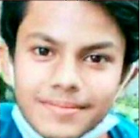

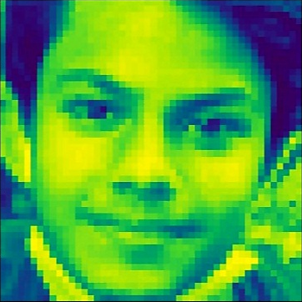
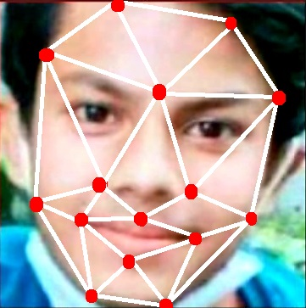

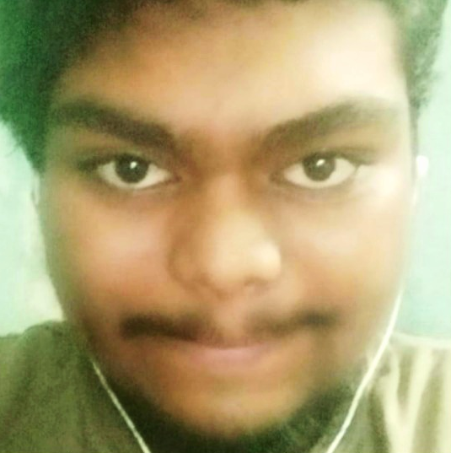
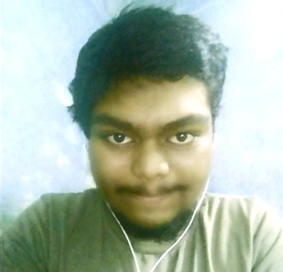
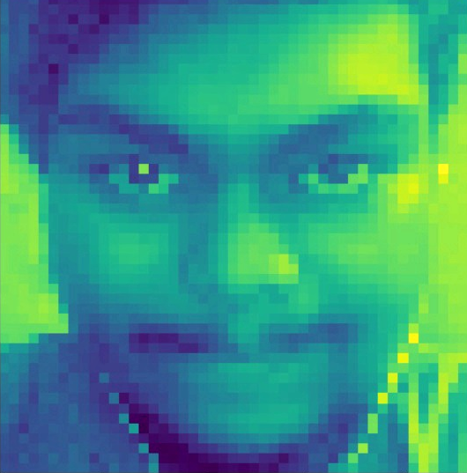
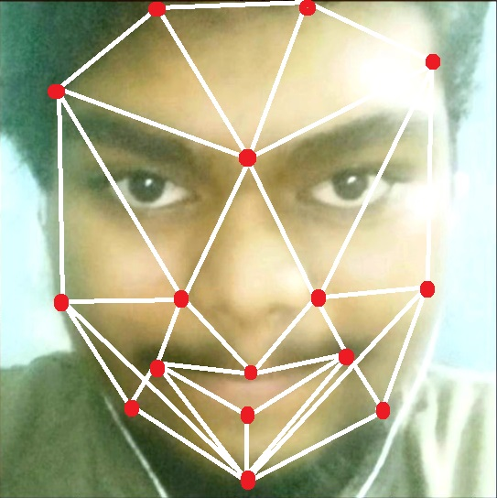
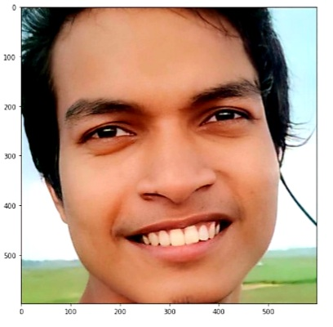
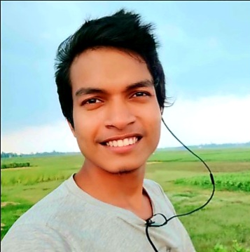
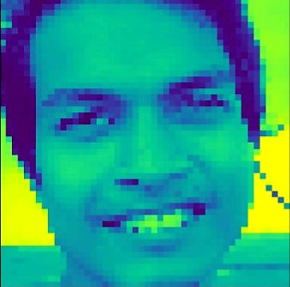
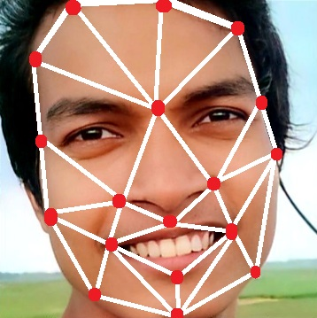
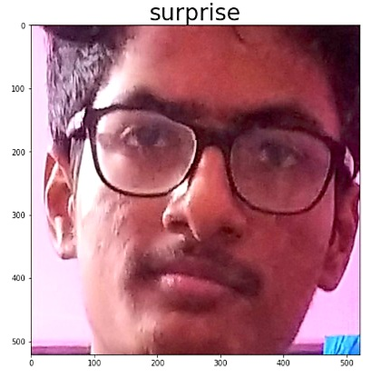
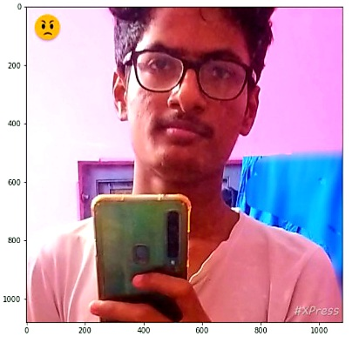
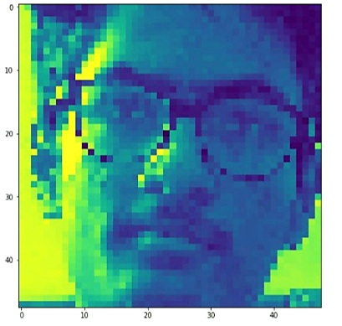
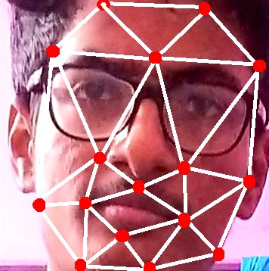
11
Example of Whole System:
Identified Expression (OutPut)
Input Image
Face Detection
Pre Processing
Facial Feature Extraction
Emotion Classification
System Will now matching with System’s Data Set !
SURPRISE
System Will now matching with System’s Data Set !
HAPPY
System Will now matching with System’s Data Set !
HAPPY
System Will now matching with System’s Data Set !
SURPRISE

Slide 14
12
Conclusion
Facial expressions Recognition is one of the most vital application area of Deep Learning and Image Processing. Working through this kind of project we learns a lot about Deep Learning, Neural Networks, specially CNN, Understand the concepts of Computer Vision, Image Processing and a great practical experience during the project.

Slide 15
13
Thank you…

